Slide 1
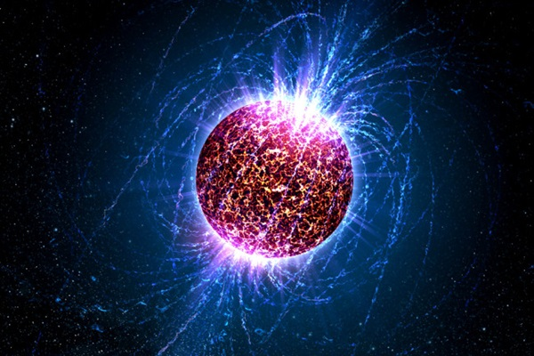
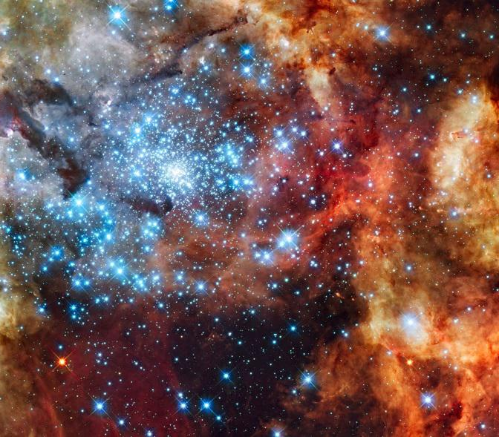
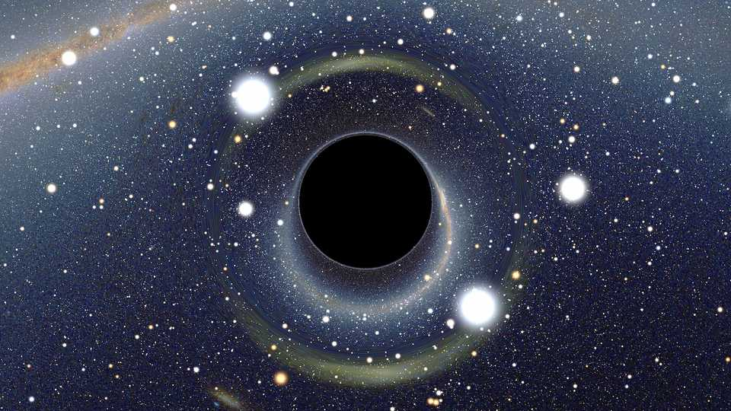
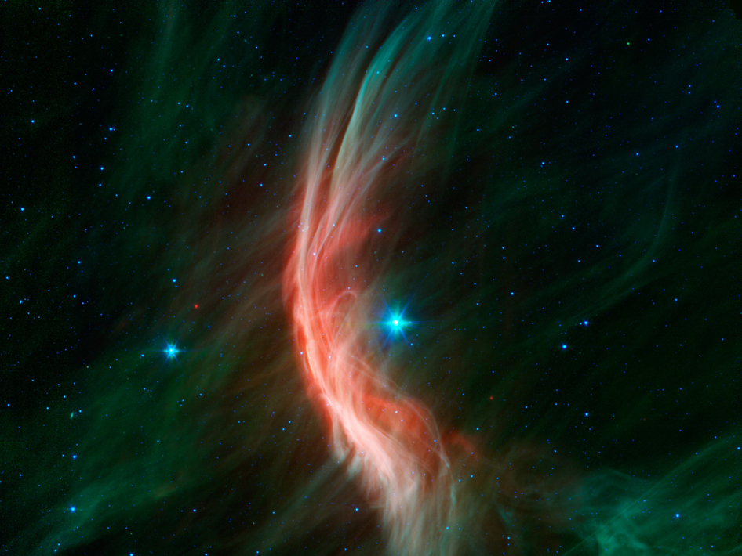
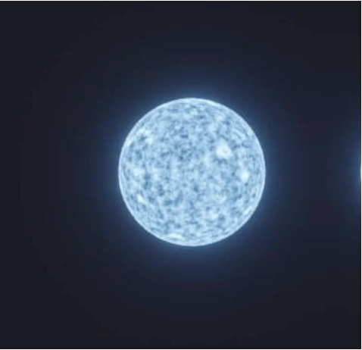
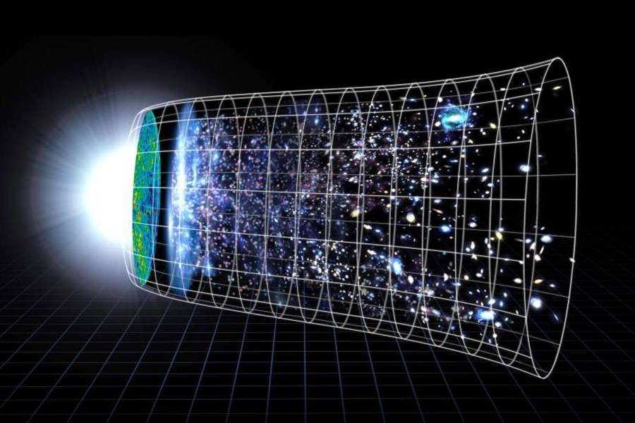
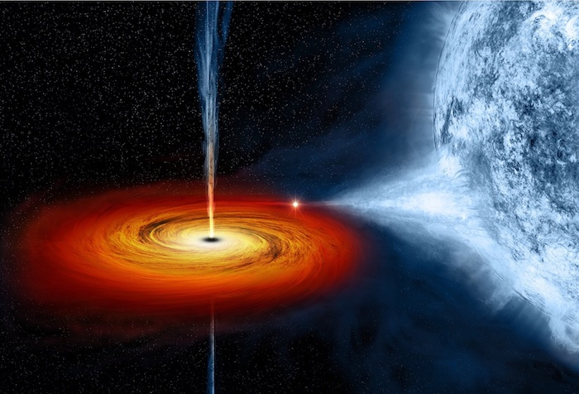

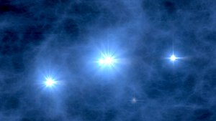
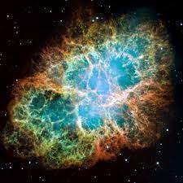
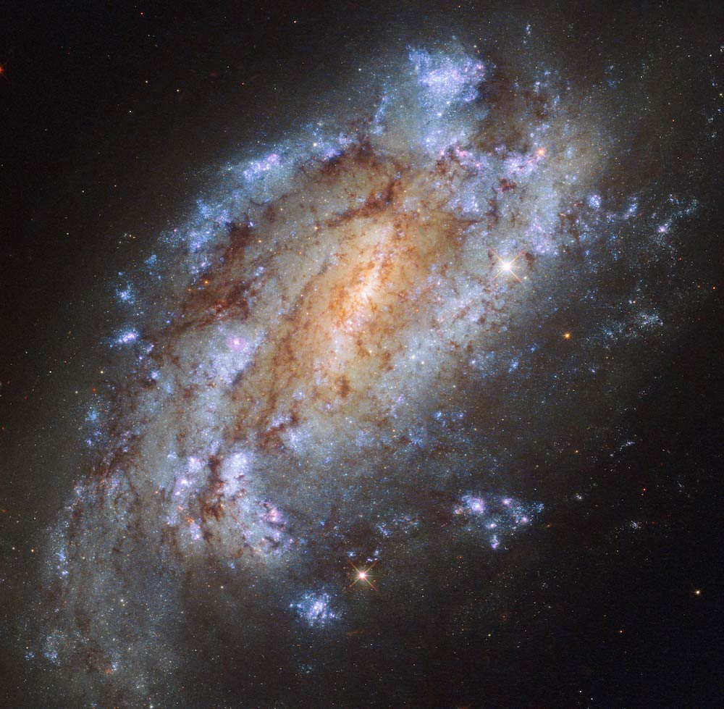
Massive Stars
Play a pivotal role in our Universe
Neutron Stars
Star Formation
Black Holes
Feedback
Cosmology
Transients
Enrichment
Reionization
Supernovae
Galaxies

Slide 2
Massive Stars
Play a pivotal role in our Universe
Neutron Stars
Star Formation
Black Holes
Feedback
Cosmology
Transients
Enrichment
Reionization
Supernovae
Galaxies

Slide 3
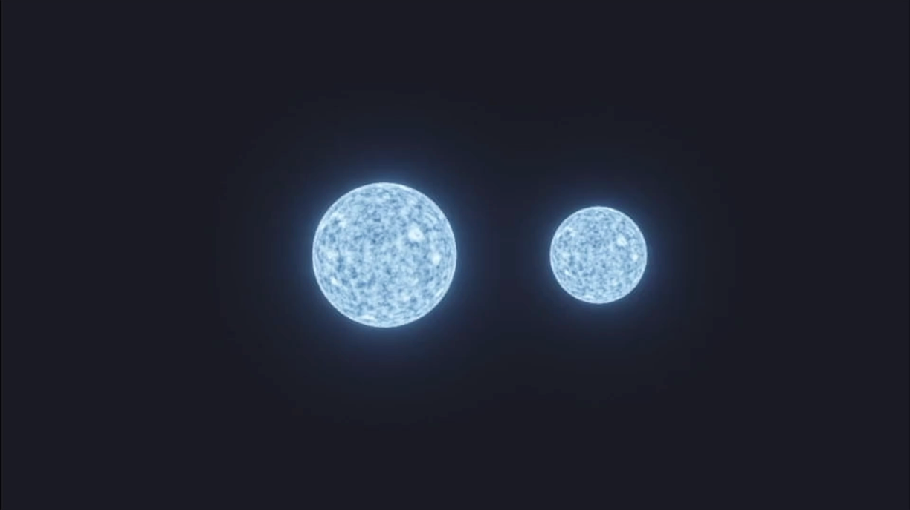
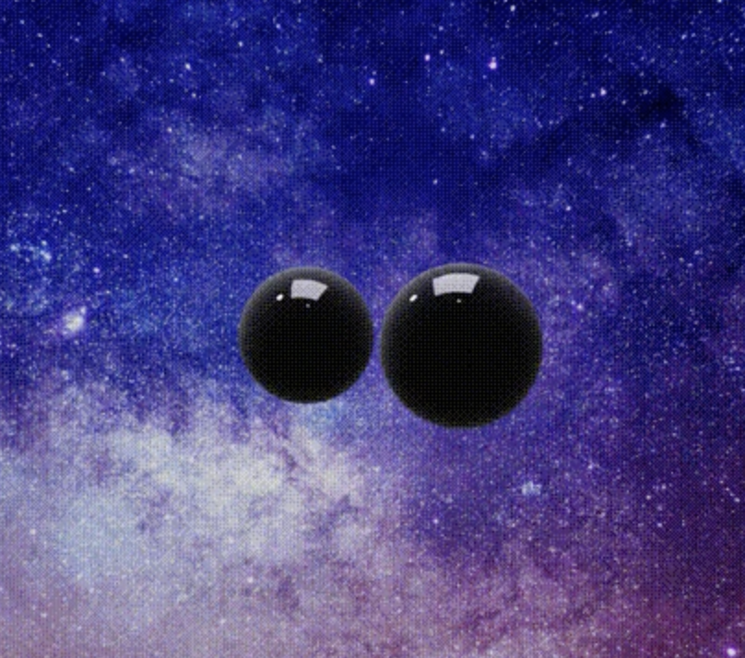
How do stars evolve?
stars in the past
observations
Gravitational Wave
Paleontology
How did they form?

Slide 4
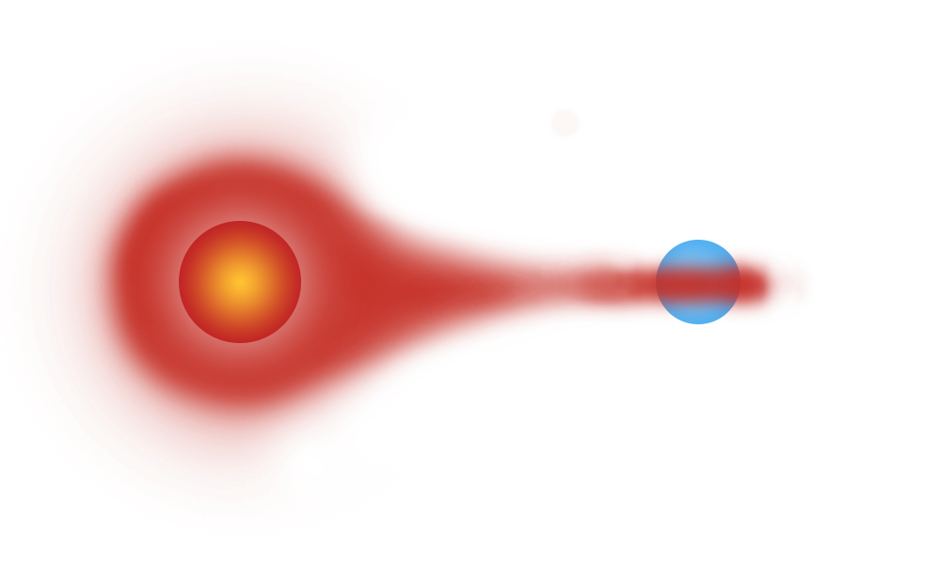



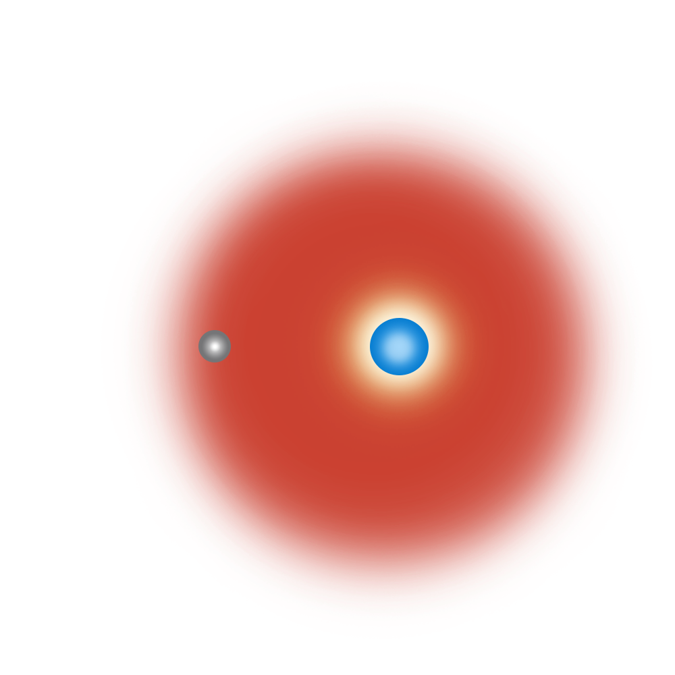

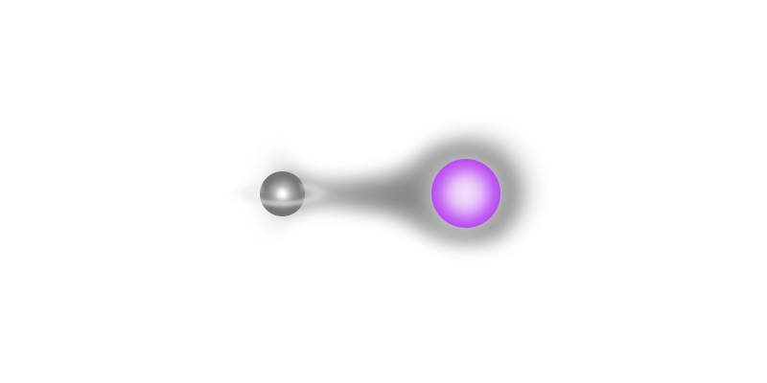

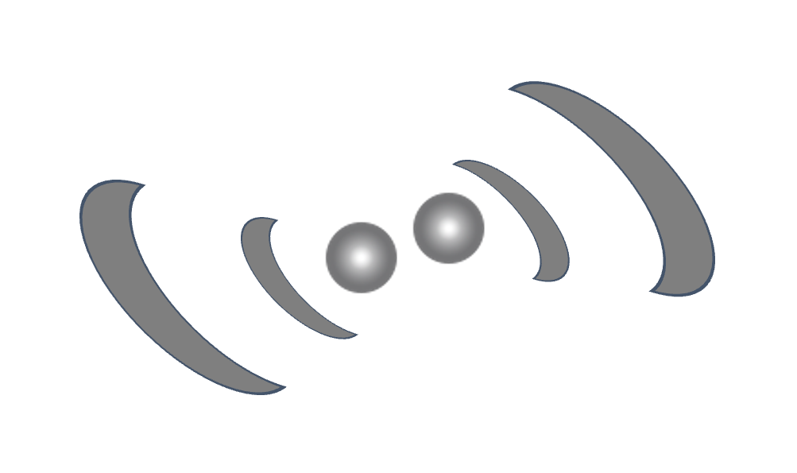
ZAMS
RLOF
post-RLOF
SN1
Case BB
mass transfer
SN2
DCO
merger
CE
RLOF

Slide 5
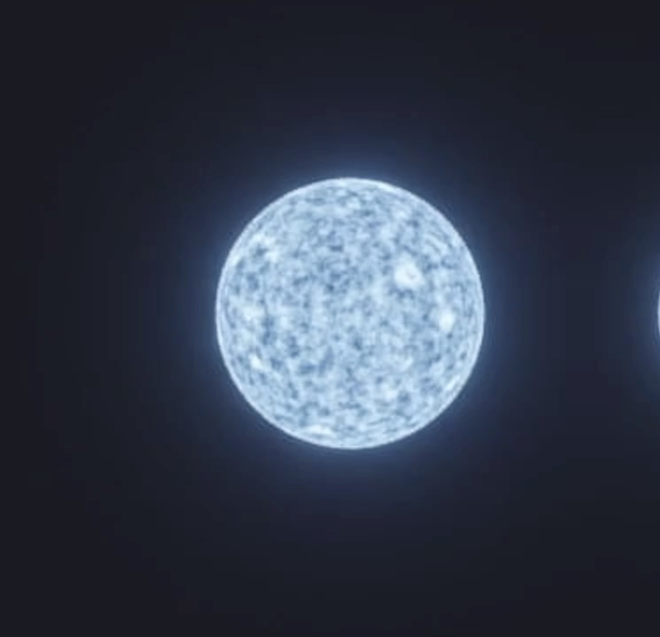

Slide 6
How do Double Compact Object Mergers form?
In the “field”
stars born in isolated binary/triple systems
“Dynamical”
stars born in dense stellar environments
“Other”
Isolated Binaries
Population-III stars
Globular Clusters
Primordial
Chemically homogeneous evolution
Isolated Triples/Multiples
Young/Open Star Clusters
Nuclear star clusters
Fly-bys
Notes:
Peters 1964: https://journals.aps.org/pr/abstract/10.1103/PhysRev.136.B1224
Mandel & Broekgaarden review: https://ui.adsabs.harvard.edu/abs/2021arXiv210714239M/abstract (also source of the formula)
Mapelli 2021 review https://ui.adsabs.harvard.edu/abs/2021arXiv210512455M/abstract and https://ui.adsabs.harvard.edu/abs/2021arXiv210600699M/abstract
Gerosa & Fishbach 2021: https://ui.adsabs.harvard.edu/abs/2021NatAs.tmp..136G/abstract
And see referecein herein

